Slide 1
IOT
Circuits & microcontrollers

Slide 2
electricity
Electricity is the movement of electrons
Electrons contain an electric charge
This charge can be harnessed to do work like lighting a bulb, providing power to your laptop, etc..

Slide 3
Ac/dc
Besides the name of a great rock band, AC and DC are acronyms for ways current can flow through a circuit
In Direct Current (DC) circuits, current only flows in one direction
In Alternating Current (AC) circuits, the flow of current is periodically reversed

Slide 4
AC/DC Applications
AC can be generated and transported at high voltages over long distances with very little energy loss and heat generation
That is why AC is used in homes and office buildings, etc…

Slide 5
AC/DC Applications
DC is used for most digital electronics (computers, radios, flat screen television, cell phones, flashlights, hybrid cars, etc.)
DC is produced from batteries
DC can be produced from AC using a rectifier (for example, a power supply) that converts AC to DC power at low voltages (typically 3.3 or 5 volts for DC circuits)
12 volts DC are typically used to control motors

Slide 6
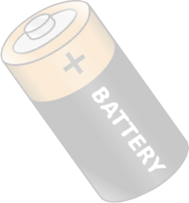
Harnessing electricity
A typical battery is rated at 1.5 volts
There are 2 terminals in a battery
The positive terminal (+) has1.5 volts of electric charge
The negative terminal (-) has 0 volts of electric charge
The difference is 1.5 volts - that’s what voltage is, the difference in charge between 2 points

Slide 7
Harnessing electricity - circuits
A circuit is a path through which electrical current flows
Electricity wants to move from higher voltage (+) to lower voltage (-)
When a conductive material (like a copper wire) is attached to the (+) end of the battery a path is created for current to flow
If we attach the other end of the conductor to the (–) end of the battery (A VERY BAD IDEA) we have created a loop or circuit
In this case, since there is no load in the circuit, we have a “short” circuit

Slide 8
Harnessing electricity - circuits
In the case of a short circuit, the power supply (battery) will attempt to provide infinite current – which may burn wires, damage components, etc..
We build circuits to do useful things like power a light bulb or make a noise etc..
The things that we are powering are called loads
A load in a circuit determines how much energy it will consume

Slide 9
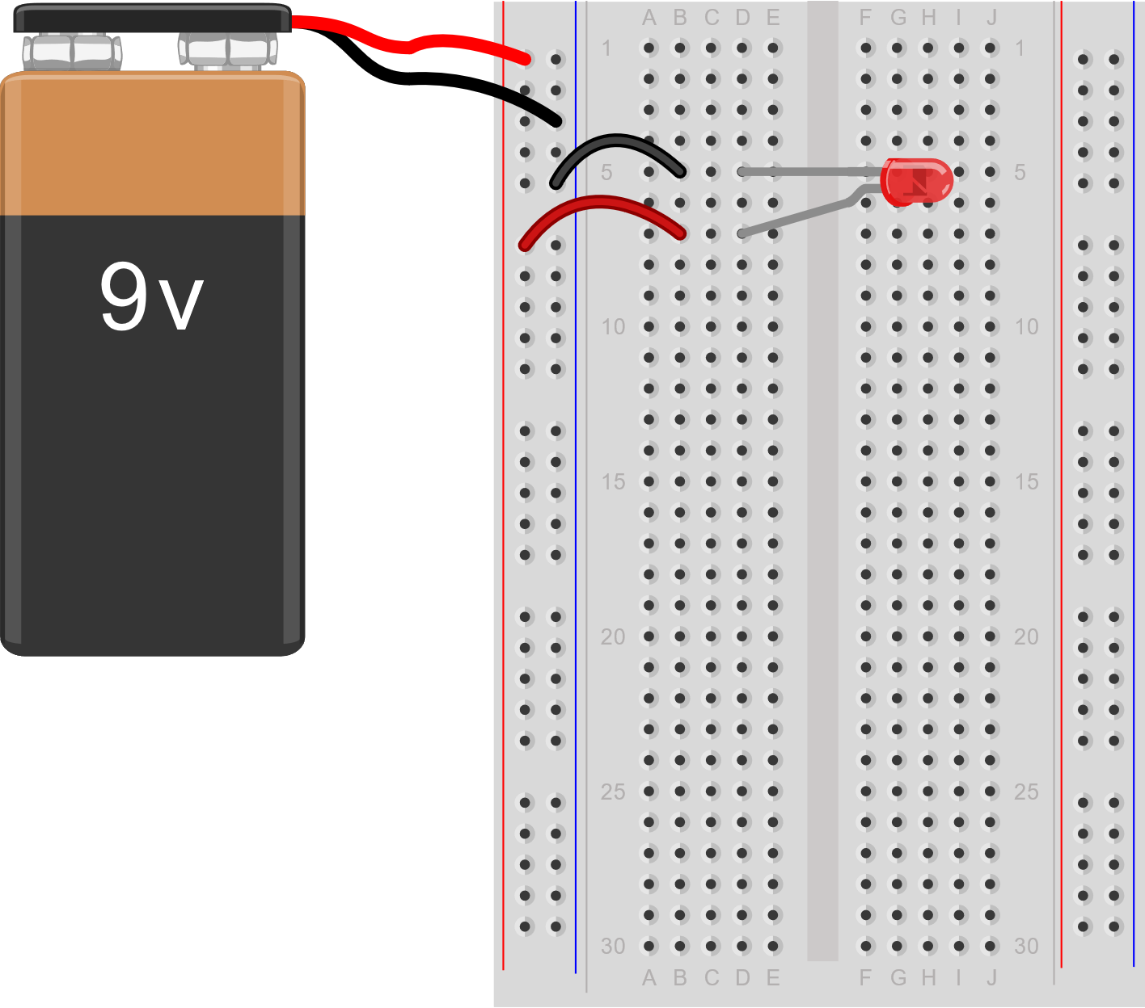
LED Circuit demo
Create a circuit with a 9V battery and an LED
Test the circuit

Slide 10
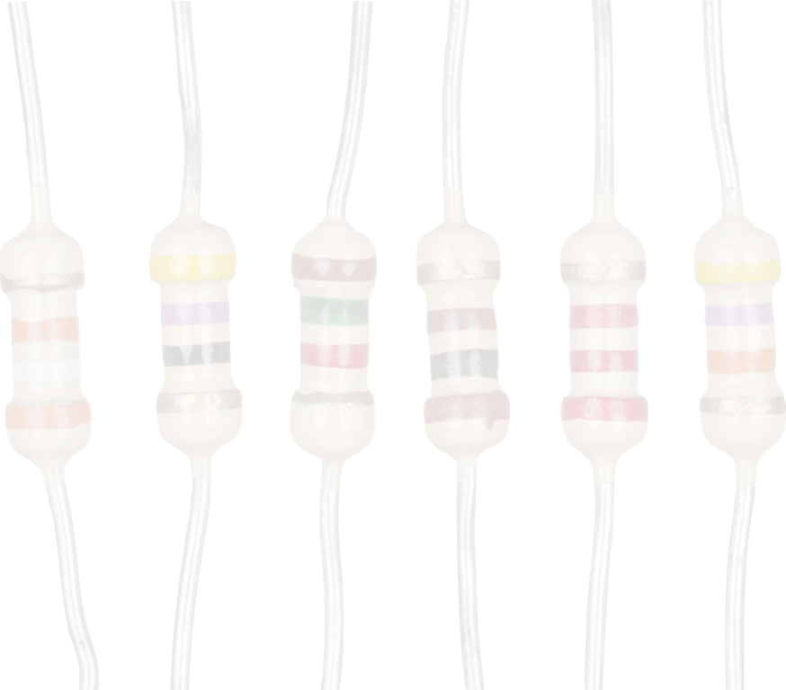
Resistance
Resistance measures how a material reduces the flow of electric current through it (unit of measure is in Ohms)
Copper and aluminum (conductors) create a very low level of resistance
Rubber (insulator) creates a very high level of resistance
The higher the level of resistance in a circuit, the less current will flow
If we want to lower the current flow in a circuit, we use a resistor

Slide 11
current
Voltage is the difference in charge between 2 points - it represents electrical potential (measured in Volts)
Resistance measures the ability to slow down the flow of electrical charge in a circuit (measured in Ohms)
Current is the flow of electrical charge (measured in Amps)

Slide 12
Ohm’s law
Ohm’s Law is used to determine proper resistance in a circuit
An LED is rated based on its forward voltage (volts) and current (milliamps) needed to power it
Our LED is rated at fV = 3.2 V and I = 20 mA
Our power supply is sV = 9 V
R = (sV - fV) / I
R = (9 V - 3.2 V) / 20 mA = .29 * 1000 (mA to A) = 290 Ω

Slide 13

LED CIRCUIT DEMO – PART 2
Create a circuit with a 9V battery, an LED light, and a 330 Ω resistor
Test the circuit

Slide 14
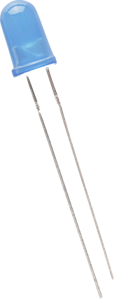
polarity
What happens if we reverse the pins on the LED light?
LED lights are polarized - they can only be connected to a circuit in one direction
Anode (long pin) - positive side of an LED
Cathode (short pin) - negative side of an LED

Slide 15
Open / closed circuits
Sometimes circuits are referred to as Open or Closed
Remember that a circuit is a loop – a path for electric charge to flow from (+) to (-)
A closed circuit is one in which there are no breaks in the path
An open circuit is one in which there is 1 or more break in the path

Slide 16
Open / closed circuits
Consider the LED circuit
What would happen if one of the wires is disconnected from the breadboard?
The circuit would be broken (open) preventing the flow of electric charge through it
Reconnecting the wire would then “close” the circuit again
Where else do you see this in everyday life?

Slide 17
switch
There are a number of different switches that can be applied to electric circuits
All switches can interrupt current in an electric circuit

Slide 18
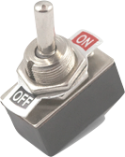
toggle switch
A toggle switch is manually activated using a lever
A toggle opens and closes a circuit
Some toggle switches can be used to redirect flow of electricity between 2 or more components
Do you have a light at home that can be turned on and off using separate switches?

Slide 19
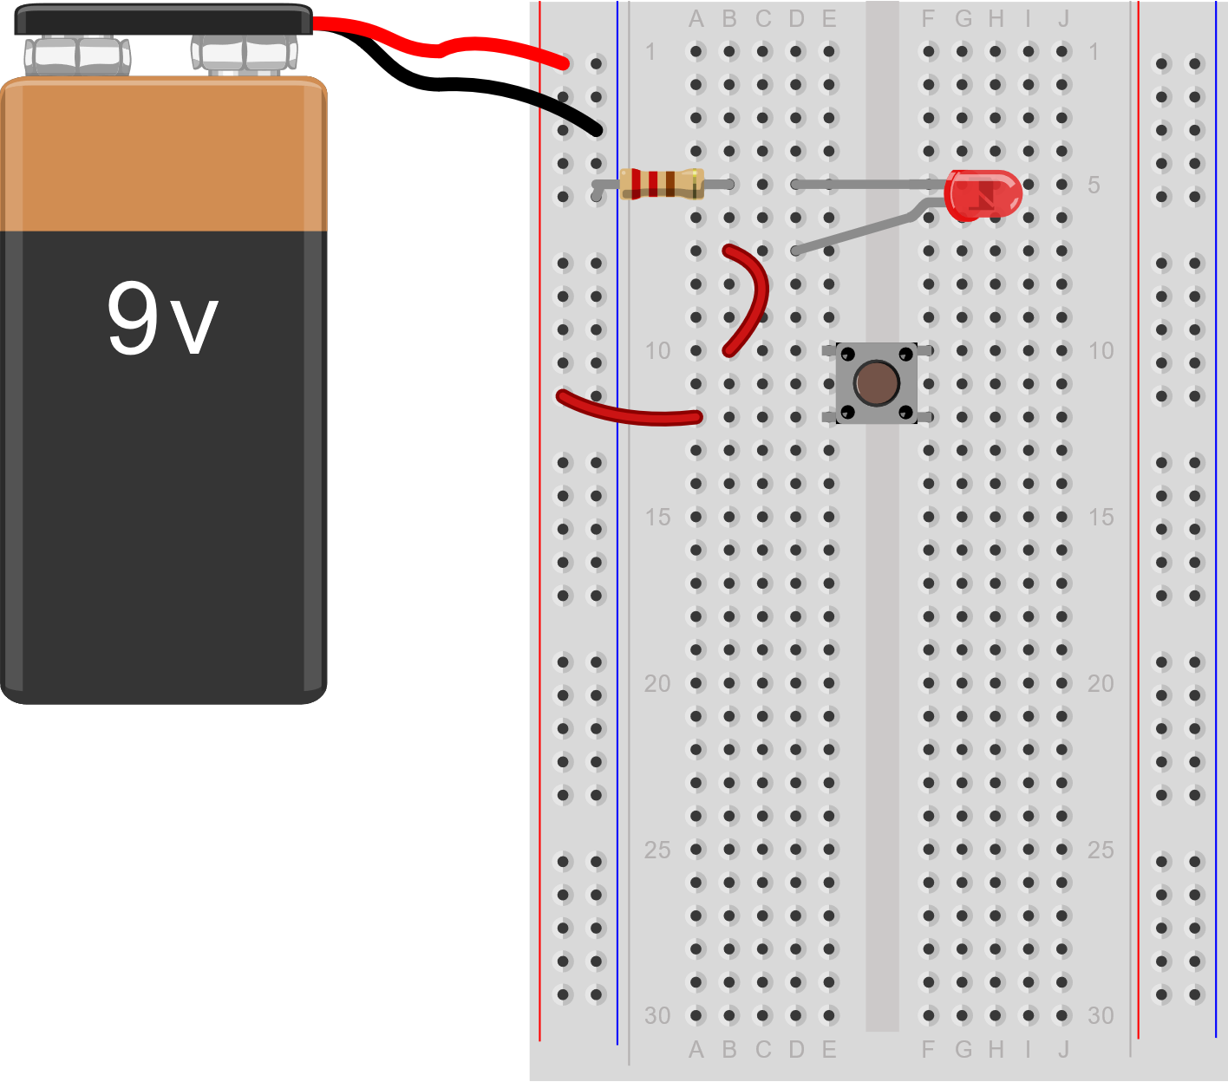
Create a switched led
Add a momentary switch to the LED circuit
Test the circuit

Slide 20
Adding components
Additional components can be added to circuits in many different ways
You may have heard of series or parallel circuits?
When components are connected in series, a broken component will break the entire circuit
When components are connected in parallel, a broken component will not break the entire circuit

Slide 21
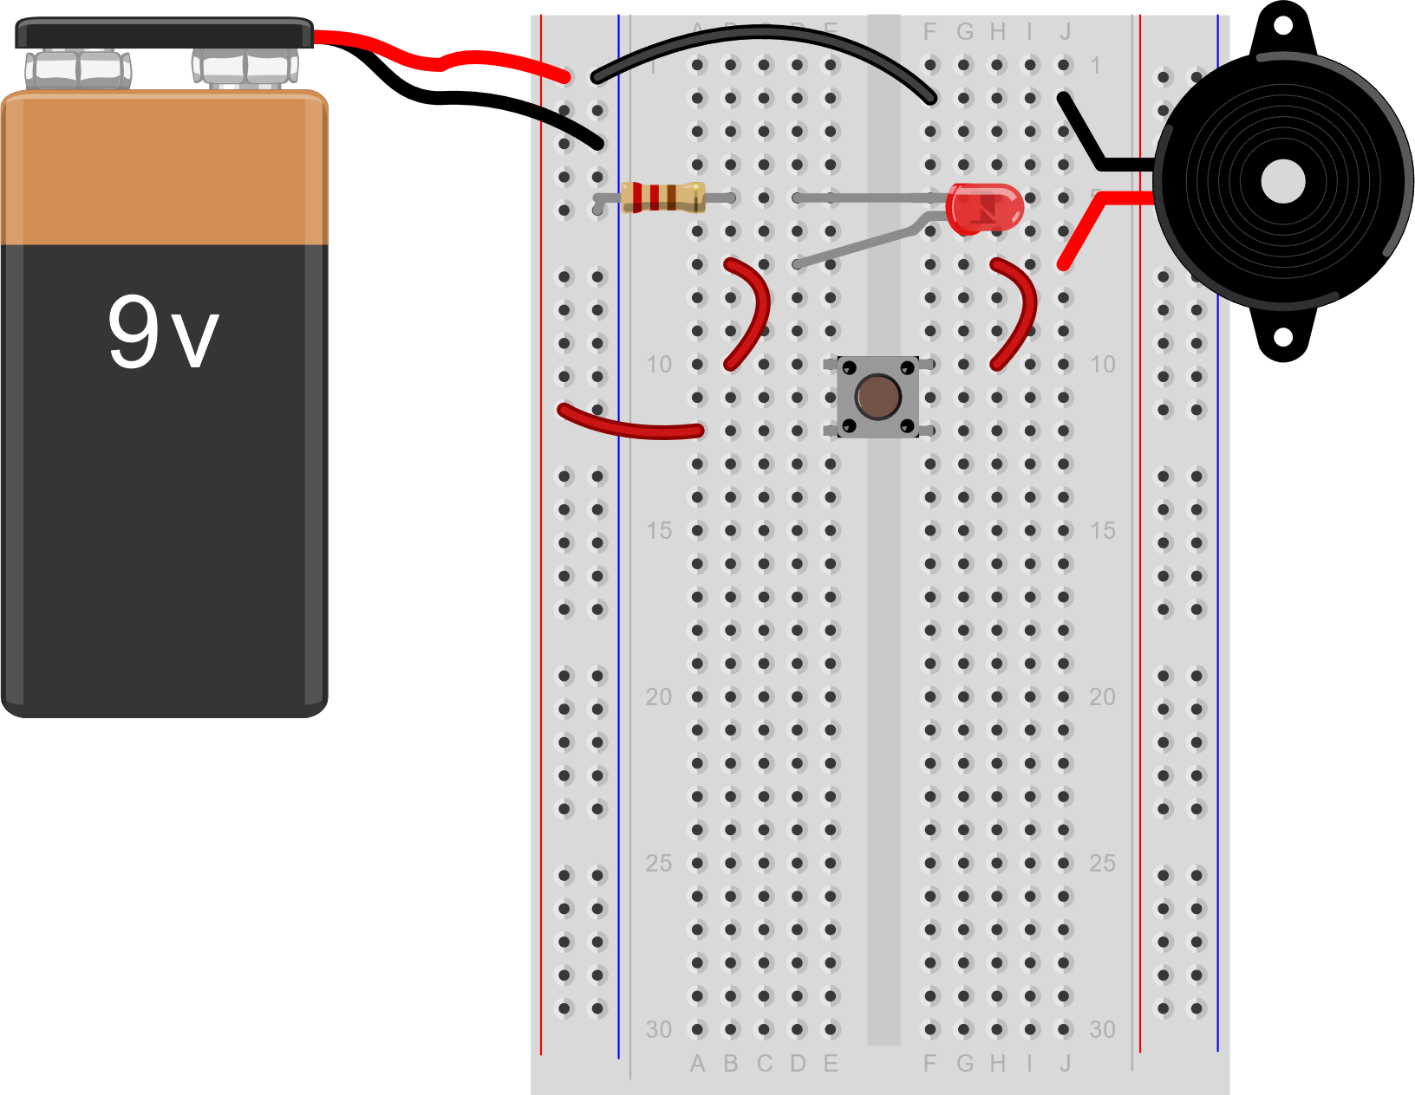
Adding components
Let’s add a buzzer to the circuit – like an LED, a buzzer is polarized
Resistance is not needed
Test the circuit

Slide 22
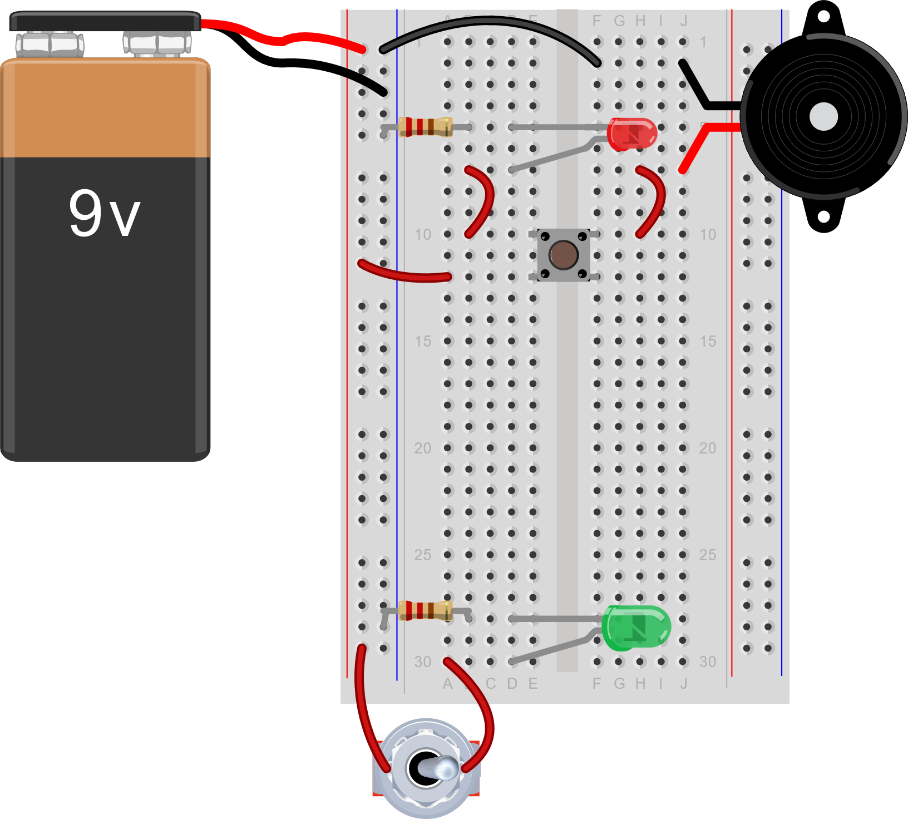
Create a toggled led
Create a new LED circuit with a toggle switch
Test the circuit

Slide 23
Relevance
So, why does any of this matter?
Digital circuits have 2 voltage states - Logic 0 and Logic 1
Logic 1 represents a “High” voltage, like 5 volts
Logic 2 represents a “Low” voltage, like 0 volts

Slide 24
Relevance
So, a circuit with low voltage represents 0 and a circuit with high voltage represents 1
Where else do we see 0s and 1s?

Slide 25
Relevance
The binary number system uses Binary Digits (BITS)
8 BITS represents a BYTE - a single character
01001010 represents the letter “J”
How many characters can be represented using 8 bits?

Slide 26
Relevance
This is how modern day computers came to be
Using “integrated circuits” storing “low” and “high” voltages to represent 0s and 1s

Slide 27
Relevance
Circuits can be created to perform tasks to help us in our daily lives
Adding a microcontroller (Raspberry Pi, Arduino), we can write programs to interact with the components in a circuit and do useful things
For example?

